Slide 1
GRIN Global Home Page
Click on Collections

Slide 2
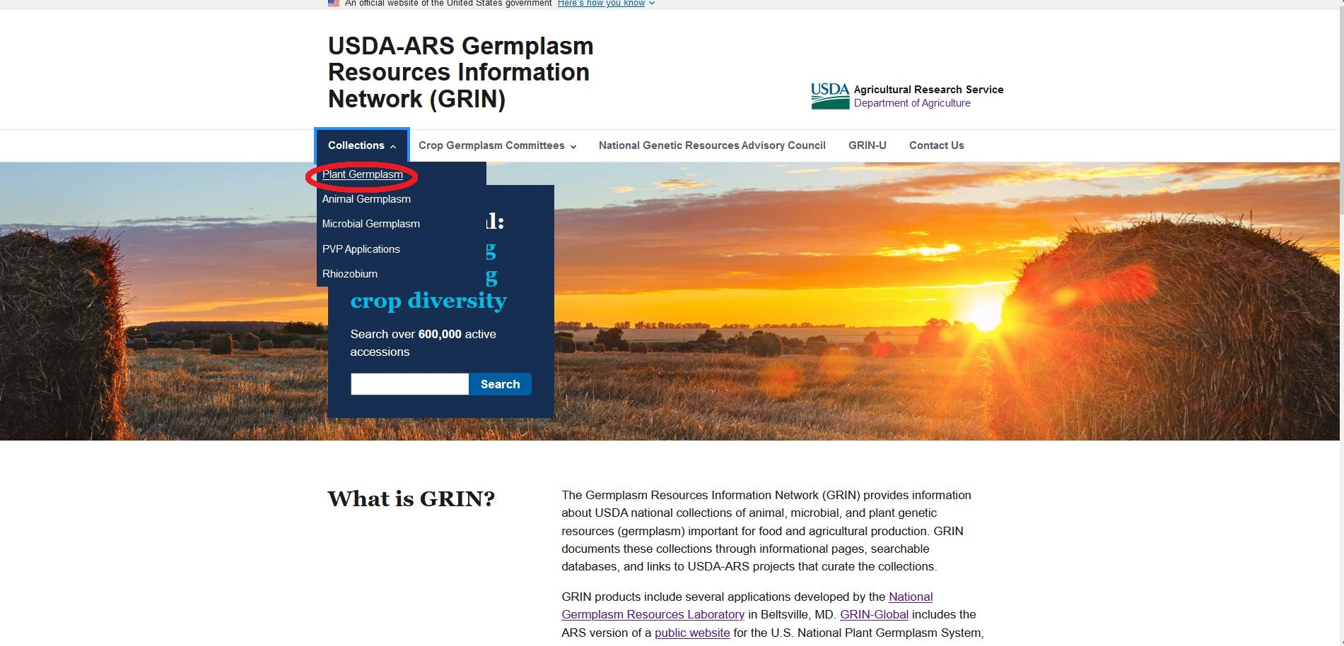
Select “Plant Germplasm” from the dropdown menu

Slide 3
Click the “SEARCH NPGS GRIN-GLOBAL” link

Slide 4
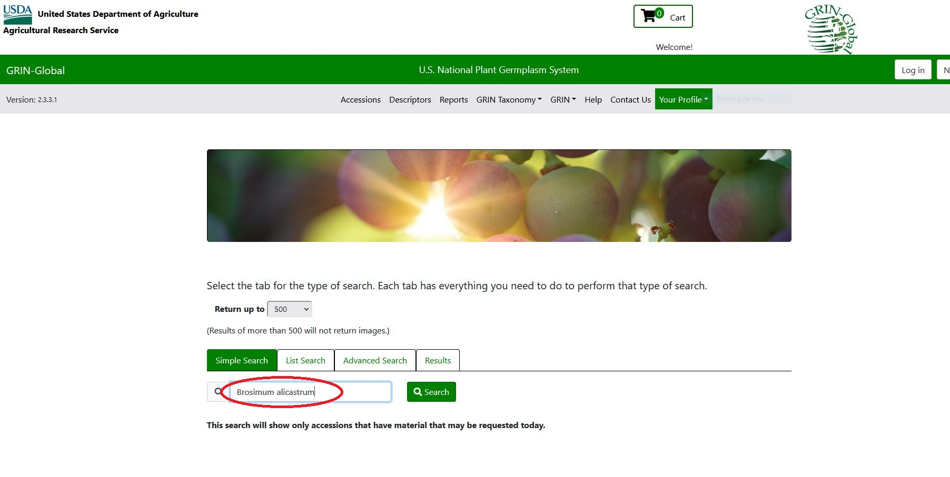
In the “Search” field enter Brosimum alicastrum

Slide 5
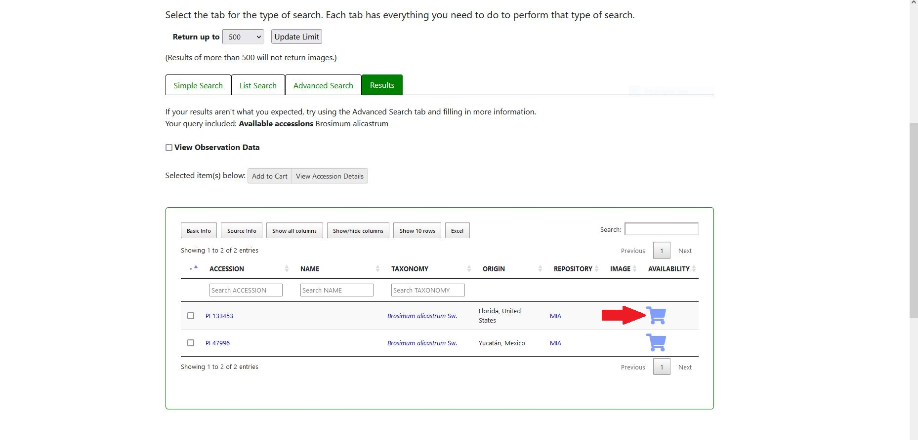
Two Brosimum alicastrum accessions will come up, add the first one to your shopping cart

Slide 6
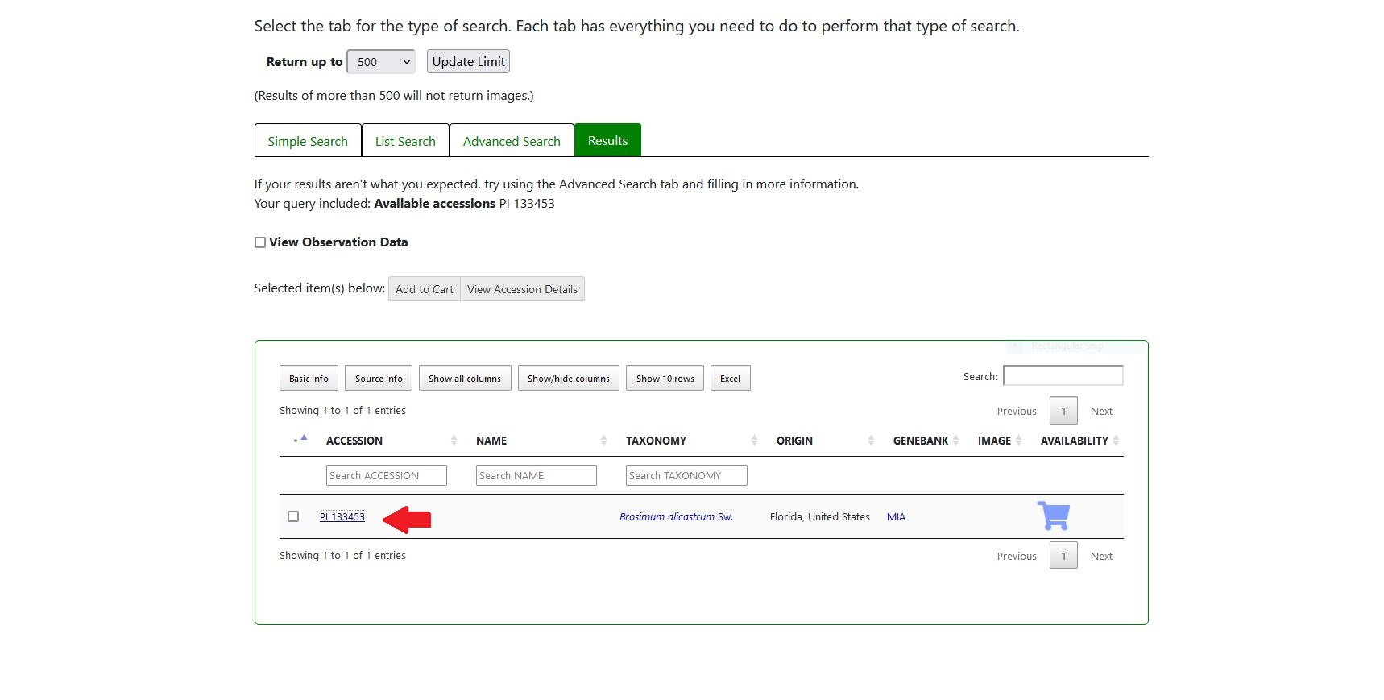
The accession number is also a link with additional information

Slide 7
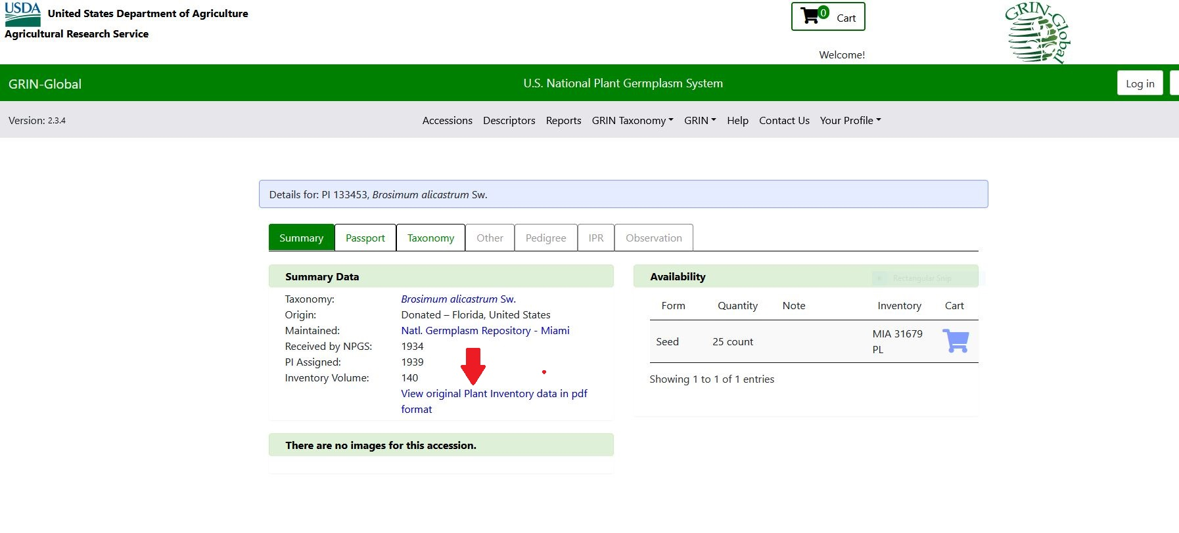
The Plant Inventory data is a downloadable pdf with the original collection data from the Plant Introduction Books

Slide 8
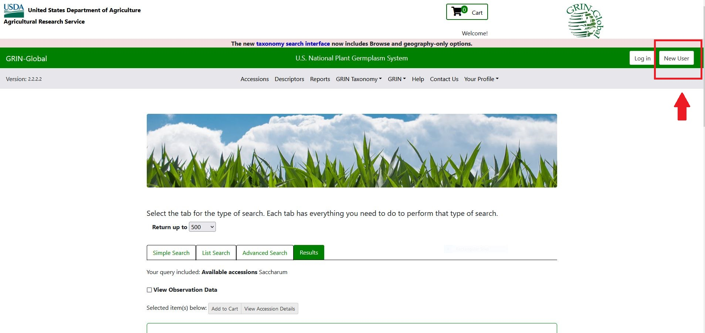
You must register in order to receive germplasm. Click the “New User” icon on top right corner of the page

Slide 9
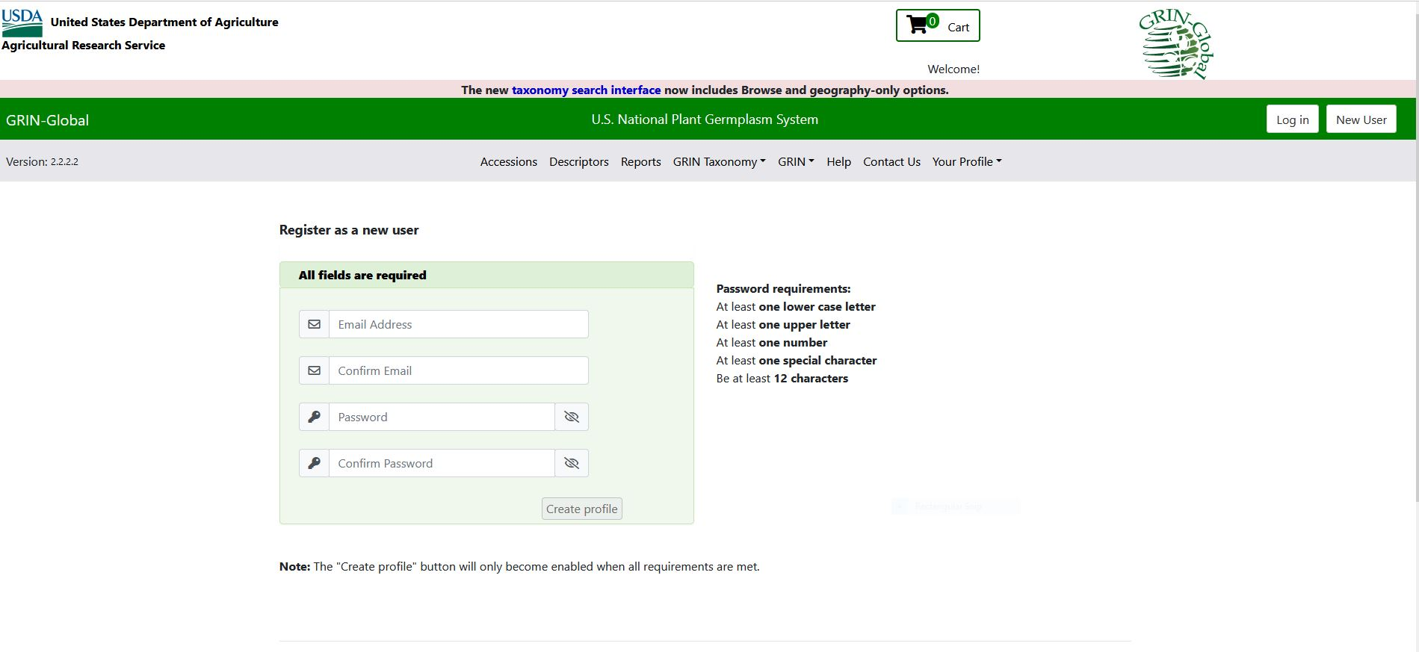
Registration will begin with setting up your e-mail address and a password. On the following pages you will add all your
contact information as well as the name of the requesting organization and type of organization you represent.
Be sure to use a physical shipping address.

