Slide 1
Mike Rowley¹, Dr. Héctor Estrada-Medina² & Dr. Iain Green¹ ¹ Bournemouth University, ² Universidad Autónoma de Yucatán
The Potential Oxalate-Carbonate Pathway of Brosimum alicastrum Sw.; Moraceae in Anse-a-Pitre, Haiti and the Yucatán, Mexico
Research funded by Sadhana Forest & Biomimicry Europa
This specific presentation is funded by a grant from the Santander Mobility Group in conjunction with Bournemouth University
Notes:
Buen dia, De-sculpe, yo no hablo mucho espangol, asi que hoy voy hablar en anglais

Slide 2
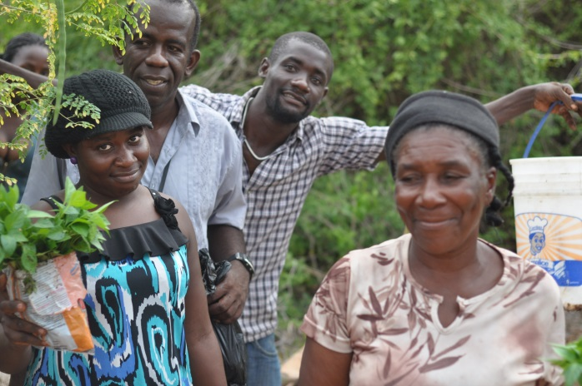
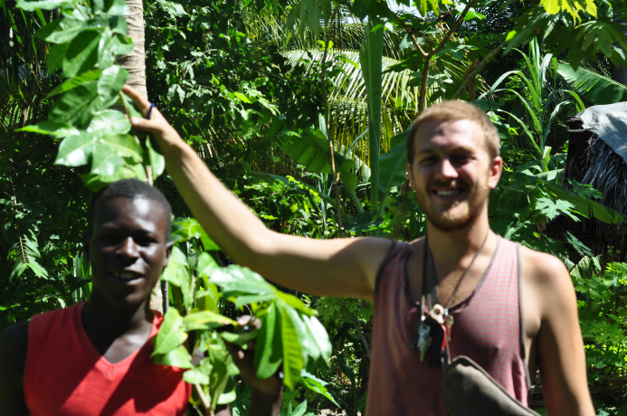
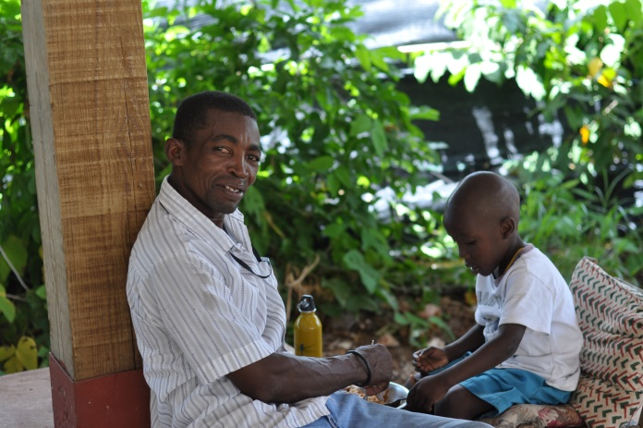
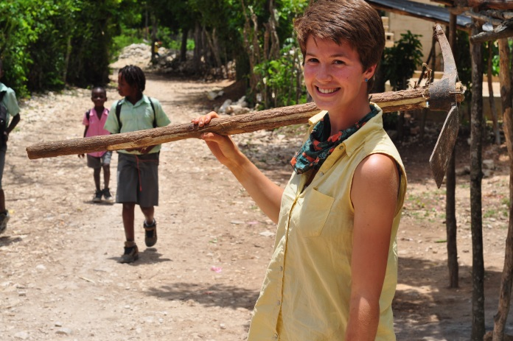
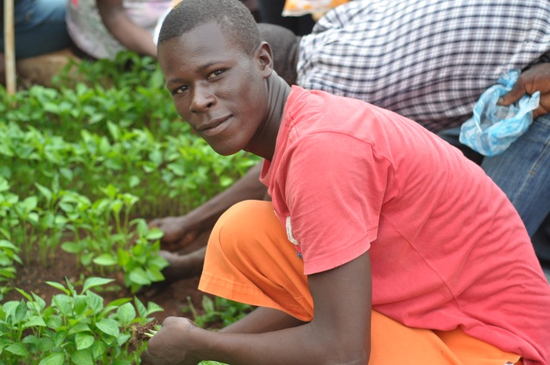
The Potential Oxalate-Carbonate Pathway of Brosimum alicastrum Sw.; Moraceae in Anse-a-Pitre, Haiti and the Yucatán, Mexico
Notes:
Hi my names Mike Rowley and I spent 5 months recently working as the director of Sadhana Forest Haiti, helping to plant trees while I completed my research. It was an incredible experience and I got to make some great friends. I originally met Aviram when I helped him design an irrigation system. As you can see from the photos above, I had a great time, I had a great time in Haiti, learned creole, and met an incredible range of lovely Haitians, truly immersing myself in the beautiful and colourful region of Anse-a-Pitre. The weather was a plus too!

Slide 3
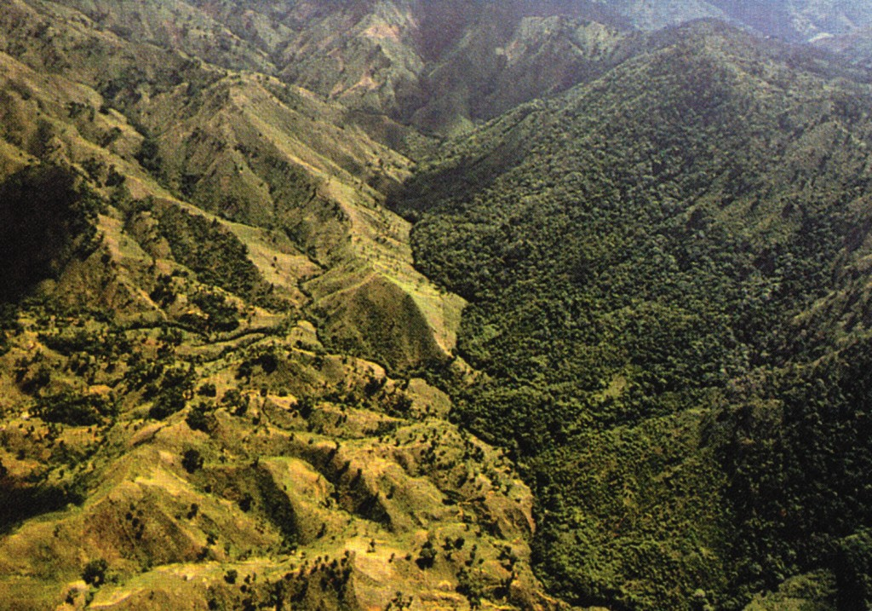
Haiti Dominican Republic Border
Notes:
About 3% of haiti’s landcover is now forested, and it has lost 13% between the years of 1990 - 2010

Slide 4
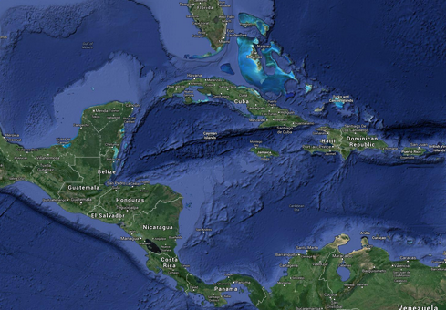
Location of Study
Neotropics
Notes:
This is the study region. The Yucatán Peninsula and Two regions in Haiti. One in the north, near Gonaives, Source Chaudes and the other in Anse-a-Pitre

Slide 5
Climate Change
Atmospheric Green House Gas (GHG) concentrations are increasing
Intergovernmental Panel on Climate Change (IPCC) now states with 95% confidence that the cause of these increases are anthropogenic (land-use change & fossil fuels)
A major source of GHG emissions from Land-use change is monoculture, mass-production agriculture
Agroforestry has the potential to produce similar quantities of food as monoculture systems, in a sustainable manner, while reducing CO2 concentrations (Stavi & Lal, 2013)
Notes:
I won’t spend long on this as I’m sure we all know the facts and figures, but atmospheric CO₂ concentrations are increasing. The lovely people at Mauna Loa observatory tell us last years average atmospheric CO2 concentration was ca. 394 ppm. The Intergovernmental Panel on Climate change states with 95% confidence that this rise in GHG concentrations, which incidentally is unprecedented for the last 420,000 years. One of the best ways of combatting these emissions is through agroforestry, but our knowledge of terrestrial biosphere carbon sequestration system is limited because its so complex.

Slide 6
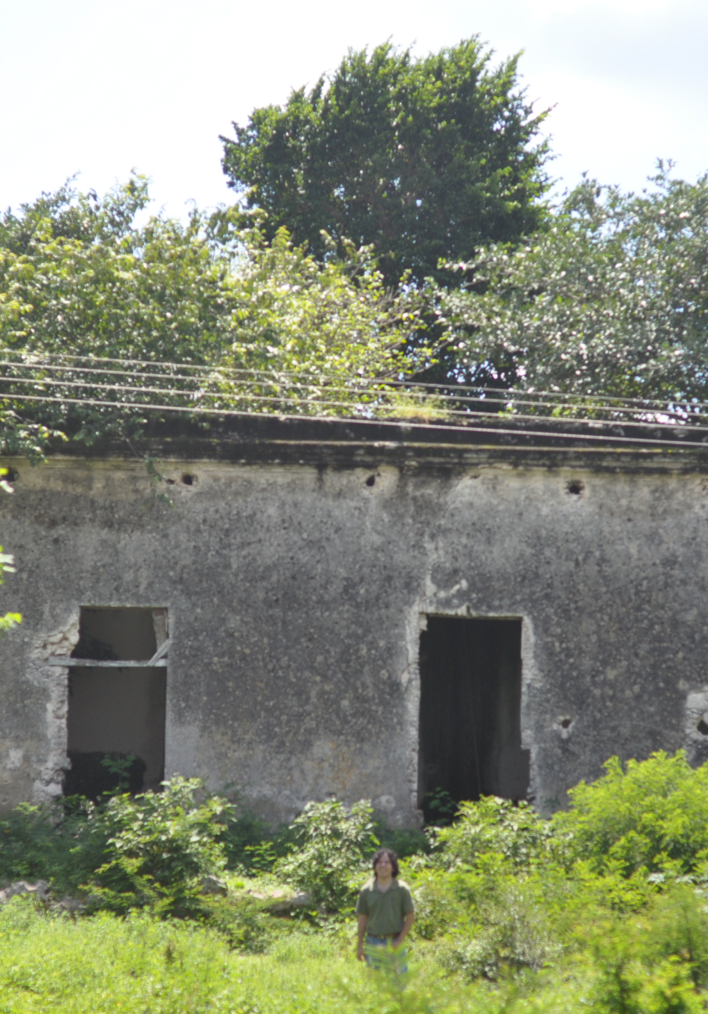
This is the Brosimum alicastrum Sw.; Moraceae
Height = 16 m
Diameter at Breast Height (1.4m) = 67 cm
Cairn’s (2003) Regression
$0.0336\left(DBH2 x Ht\right)$
Dry Biomass= 2,382 kg
Notes:
this is the tree that Aviram has been talking about, Brosimum alicastrum, it is a large neotropical evergreen Canopy species that can grow up to 25-40 m^{t} and 1 – 1.5 m dbh. As you can see that’s Oscar down there! this specific tree was in the Yucatán, Mexico and was about 16 m, had a dbh of 67cm. Using Cairns et al. 2003 regression model inferred from the harvest of 25 fully matured Brosimums in the Yucatan peninsula: 0.0336 x dbh2 x th which for this tree gives you an approximate dry biomass of 2,382 kg

Slide 7
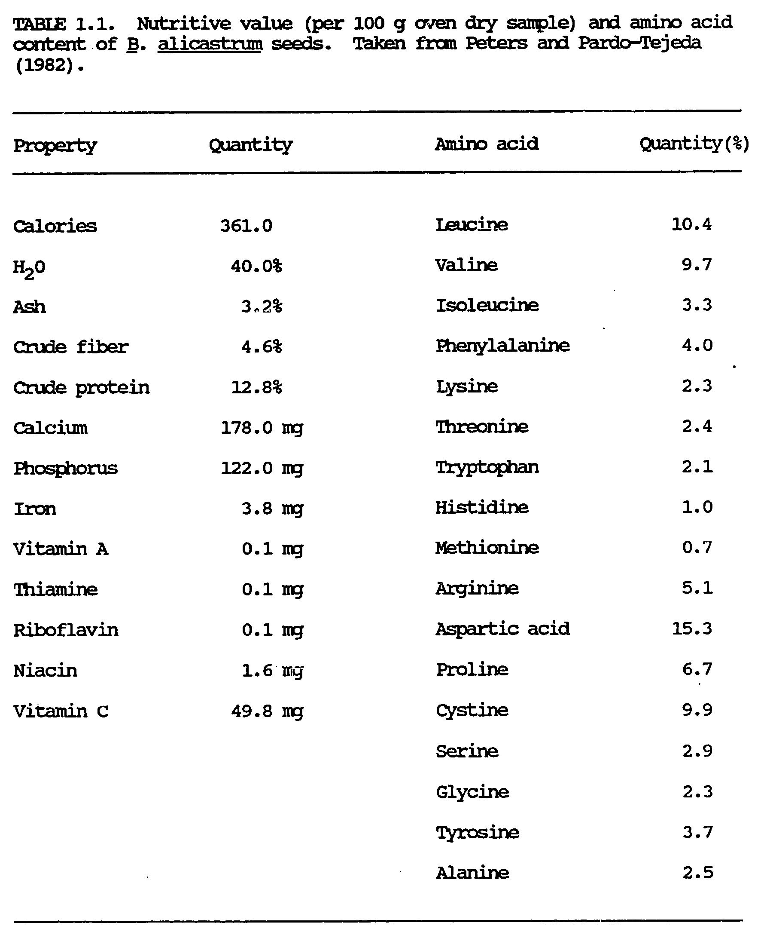
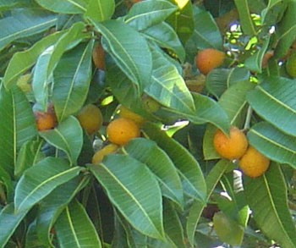
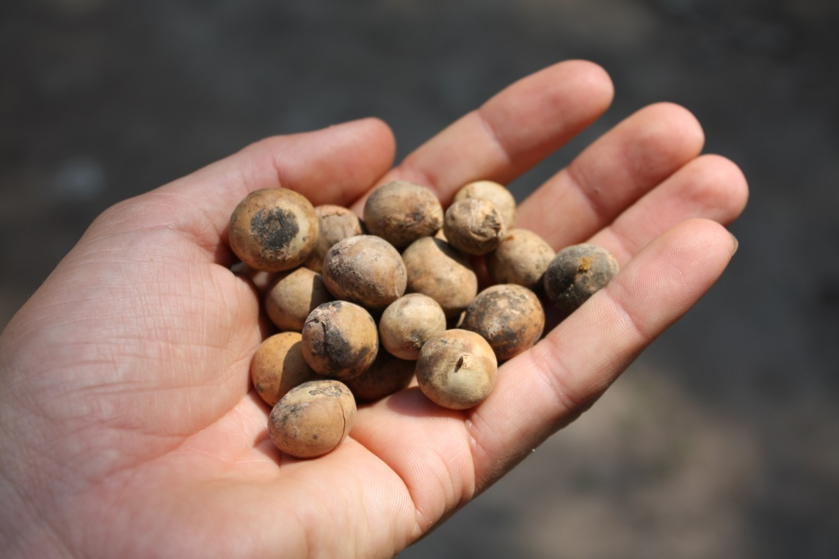
Maya Nut Seeds 70-200 kg yr ⁻¹
Table taken from Peters & Pardo-Tejeda, 1982
Notes:
The species has important agro-forestry potential as they produce ca. 70-200 kg nut yr⁻¹ after reaching sexual maturity at the age of 5-7 years of age and. The tree is drought resistant and can grow in extremely well in poor, leached soils
Here is a picture of the Brosimum nuts and as you can see from this table taken from Peters and Tejeda’s 82 paper they are anti-oxidant, extremely nutritious, and contain almost 4 times as much quantity of certain amino acids as corn. In Mexico the trees are mainly used for fodder to feed cattle

Slide 8
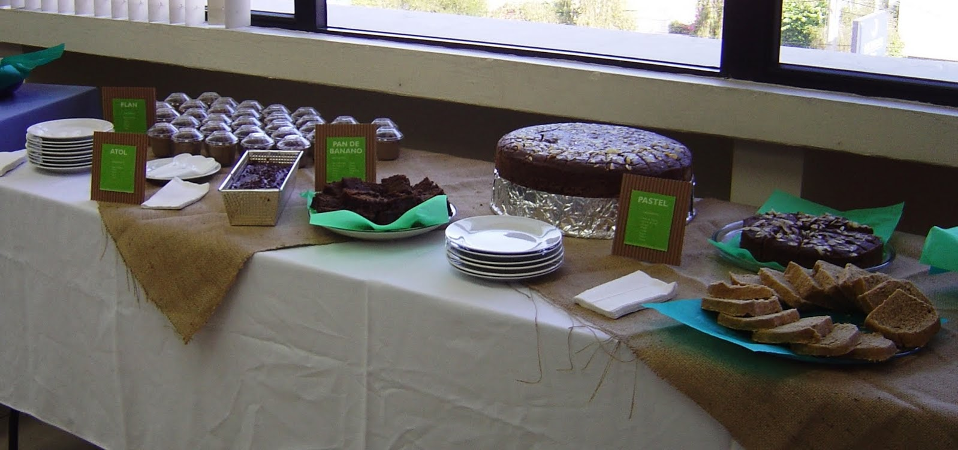
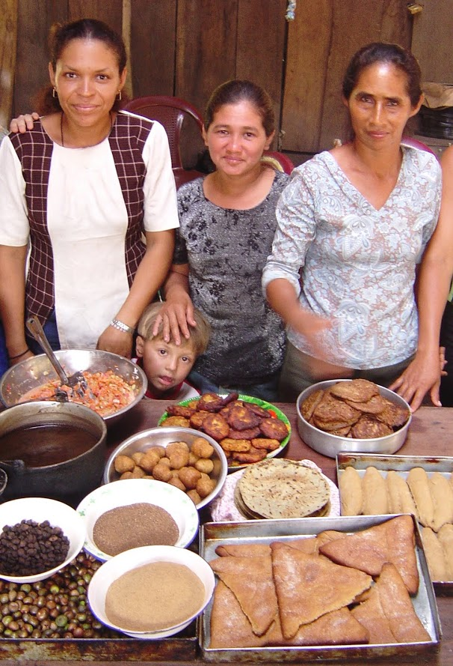
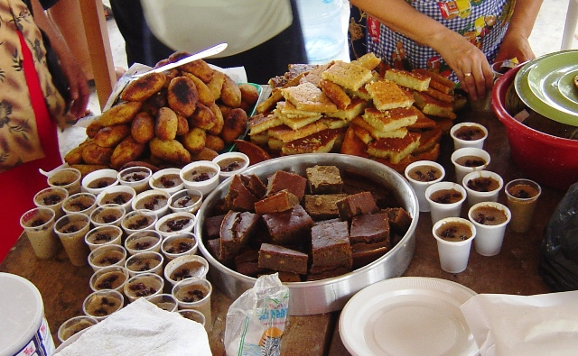
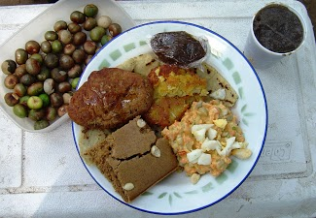
Food made with B. alicastrum seeds
Images from the Maya Nut Institute, 2013

Slide 9
The Oxalate-Carbonate Pathway (OCP)
What is OCP?
Certain plants produce Ca-oxalate crystals $(CaOx; CaC_{2}O_{4} . nH_{2}O)$ utilising organic carbon from atmospheric CO₂ that is formed during photosynthesis
The insoluble $($K_{sp} $2.32 x 10^{−9}$ at 25 °C$)$ Ca-oxalate collects in nearby soils as the tree discards organic matter and excretes crystals from its roots
This abundance of oxalate is then broken down by Oxalotrophic bacteria to form limestone (CaCO3 + CO2 + H2O), successfully sequestering CO2 in the ground, in a inert and stable format
Notes:
My study focuses on the potential Oxalate Carbonate Pathway of Brosimum alicastrum. OCP is a biomineral carbon sequestration process in which an oxalogenic species of tree, combines with fungi and oxalotrophic bacteria to sequester significant amounts of CO2 in the ground in the form of CaCO3. in over 215 families of angiosperms and gymnosperms (McNair, 1932) and within the wood structures of over 1000 genera of trees as either intra- or extra-cellular deposits .
It is thought that plants originally produced insoluble Ca-oxalate to prevent toxic levels of soluble Ca from forming in their systems, but there are a range of secondary functions; such as protection from herbivory with plants actually increasing the production of Ca-oxalate in the presence of herbivores. This is also why people working in Tequila factories get rashes, because the agave plant contains high quantities of Raphide Ca-oxalate Crystals.

Slide 10
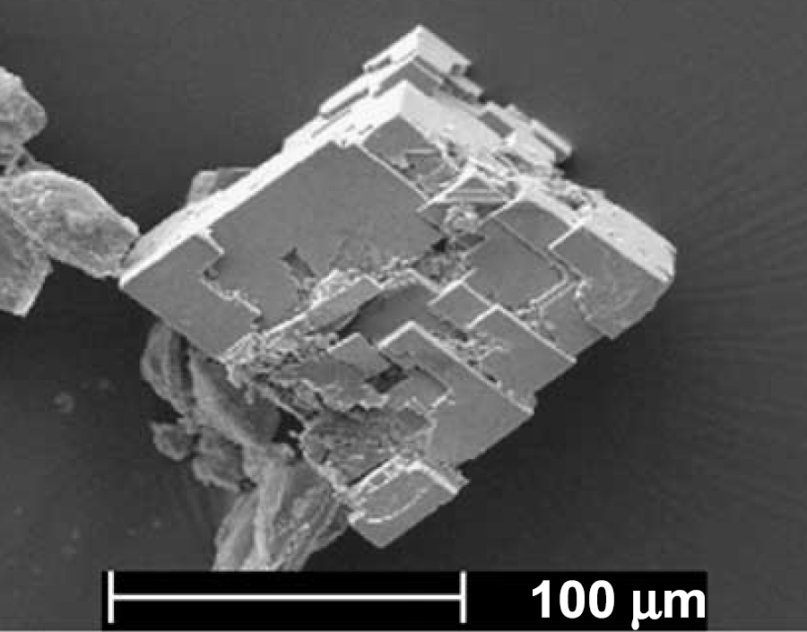
Calcium-Oxalate Crystals $(CaC_{2}O_{4} . nH_{2}O)$
Building blocks of the Oxalate-Carbonate Pathway
Image of a prismatic rhombohedra Ca-oxalate crystal photographed with a Scanning Electron Microscope at 100 μm, located within the sap of sampled Milicia excelsa, in Biga, Ivory Coast taken from Cailleau (2005).

Slide 11
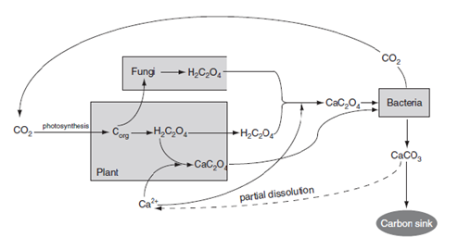
Diagram of Oxalate Carbonate Pathway
Soil
Air
Tree
Adapted from Verrecchia et al. (2006)
Notes:
Here is the simpliest model available for OCP. Here you can see CO2 is absorbed by plants during phototrophy. There are then two pathways. Oxalic acid produced by plants is combined with Ca in the mycelium of fungi or in crystal idioblasts of plants. When the organic matter is broken down oxalotrophic bactera convert the Ca-oxalate into Calcium carbonate. Releasing CO2 and sinking one mole of Carbon in a far more permanent state

Slide 12
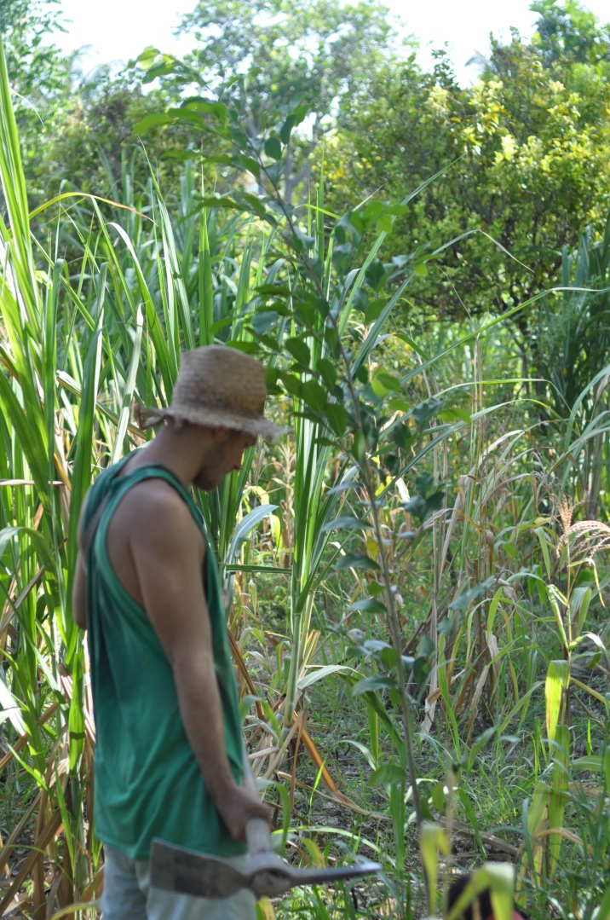
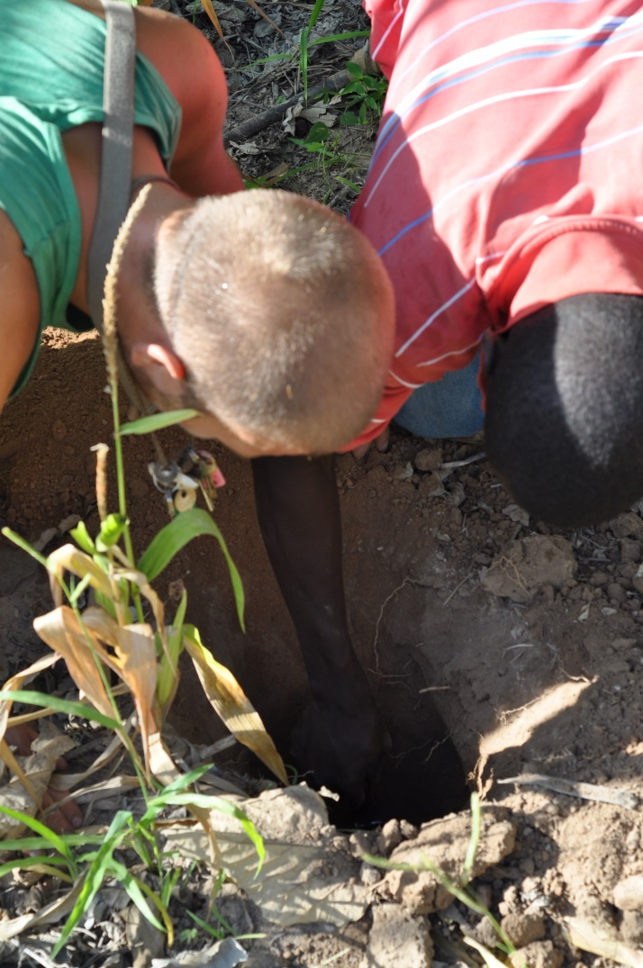
Soil and Leaf Sampling, to assess Oxalate levels in the tree and the adjacent soil
Digging, digging, and more digging, with lots of friends in both Haiti and Mexico
Notes:
You really don’t find out who your friends are until its time to dig hundreds of holes! We would have dug over 200 holes in total and sampled leaves, branches, roots, and the sap of the tree as well. The tree gives off a brown latexy residue.

Slide 13
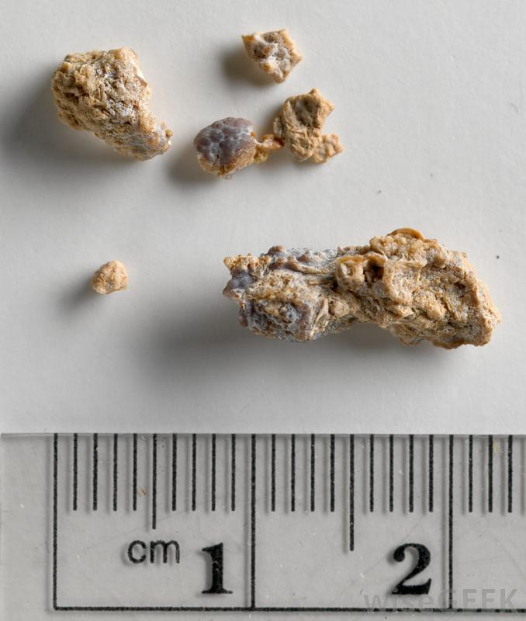
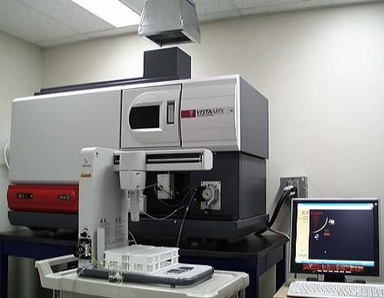
What will the Sample Analysis Involve?
ICP-OES technology
Inductively coupled plasma optical emission spectrometry. It measures elemental composition of liquids and available Calcium for OCP
Samples are first digested using microwaves and Nitric acid (HNO3)
The ICP then sprays this across an argon plasma flame (10,273 ̊̊C )
This produces excited atoms and ions, which produce colours that tell the machine what elements are in the sample.
Detects 82 elements from one sample in under a minute
Enzymatic Oxalate Analysis
Can guess what these are?
Kidney stones – Apparently the male equivalent of giving birth
Some Mammals, like Plants, can produce oxalate which can group into stones of calcium carbonate.
The analysis for quantities of oxalate in plant material or soils is identical to the analysis of human urine for detecting kidney stones.
Notes:
Can anyone guess what these are? They are kidney stones. Mammals like plants biosynthesise Ca-oxalate which can lead to problem deposits such as these in the kidneys. The test for kidney stones in human urine is the same analysis I will use to determine the Ca-oxalate levels of soils and plant material The other analysis I will use is ICP-OES this machine can detect 82 elements from one sample in under a minute. It is extremely quick and sprays an aerosol from my samples across a plasma Argon flame to detect the mass to charge elemental ratios of my samples. Basically giving me an exact compositional analysis of the soils. This will enable me to test for available Ca in the soils for OCP, Micro / Macro Nutrients and also possible heavy metal contamination, as a by-product.

Slide 14
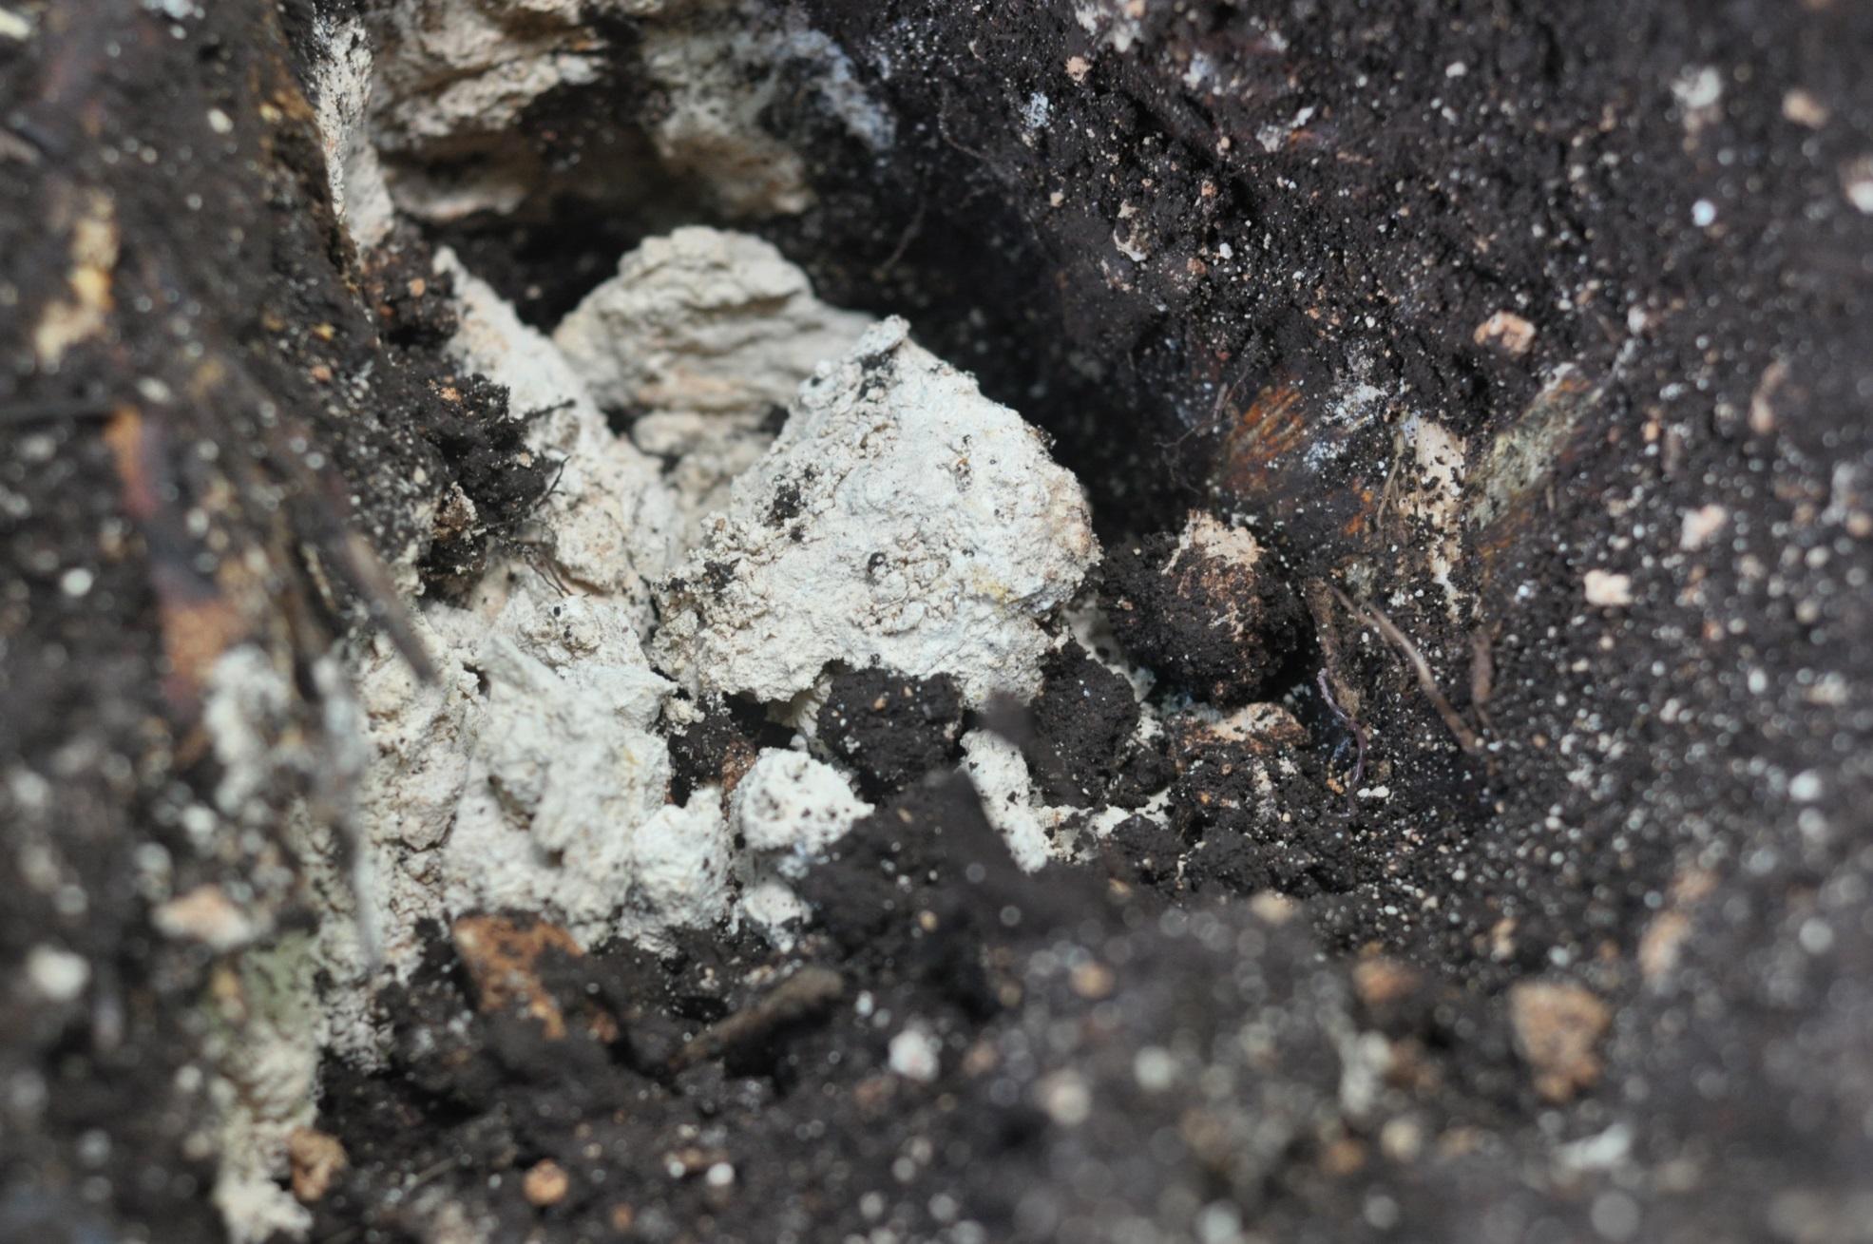
Promising Observations of Precipitated Calcium Carbonate (Limestone) in the Soil
Notes:
I have not started the analysis yet but there was some extremely promising signs… Questions?

Slide 15
So Why is This Research Important?
Questions?
Carbon stored as limestone through OCP stays stable for (100-1,000,000 yrs) 1,000 times longer than carbon stored in trees (10-1,000 yrs)
Previously investigated Oxalogenic trees (Micilia excelsa, Afzelia africana, and numerous Cacti species) don’t produce as much food as B.alicastrum
Milicia excelsa an African timber tree, was shown to sequester enough carbon to effectively mitigate global carbon emissions for a 1 km² chunk of atmosphere
Notes:
So what does this mean? Well for a start Biominerally sequestered carbon is far more stable than organically sequestered carbon, staying in the ground for a 1000 times longer.
Previously analysed Oxalogenic trees (Micilia excelsa, Afzelia africana and numerous Cactaceae species) have not had the same agro-forestry potential as Brosimum.
At the moment people spend a lot of money through carbon credit systems on planting forests in developed countries to organically sequester carbon.
If we can prove this tree is oxalogenic it could have major impacts on the current Voluntary Carbon Offset and associated carbon credit systems, that could ultimately provide funding to agro-forestry initiatives in developing neotropical countries like Haiti

